Slide 1

Research Storage Simplified
John Reiland
RC Template Presentation
Presenter Name

Slide 2
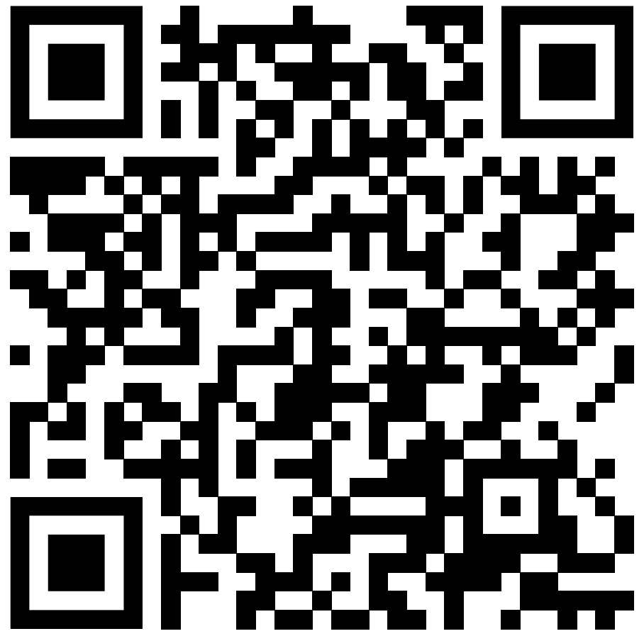
View the Slides [replace QR code and link!]
https://github.com/ResearchComputing/research_storage_simplified

Slide 3

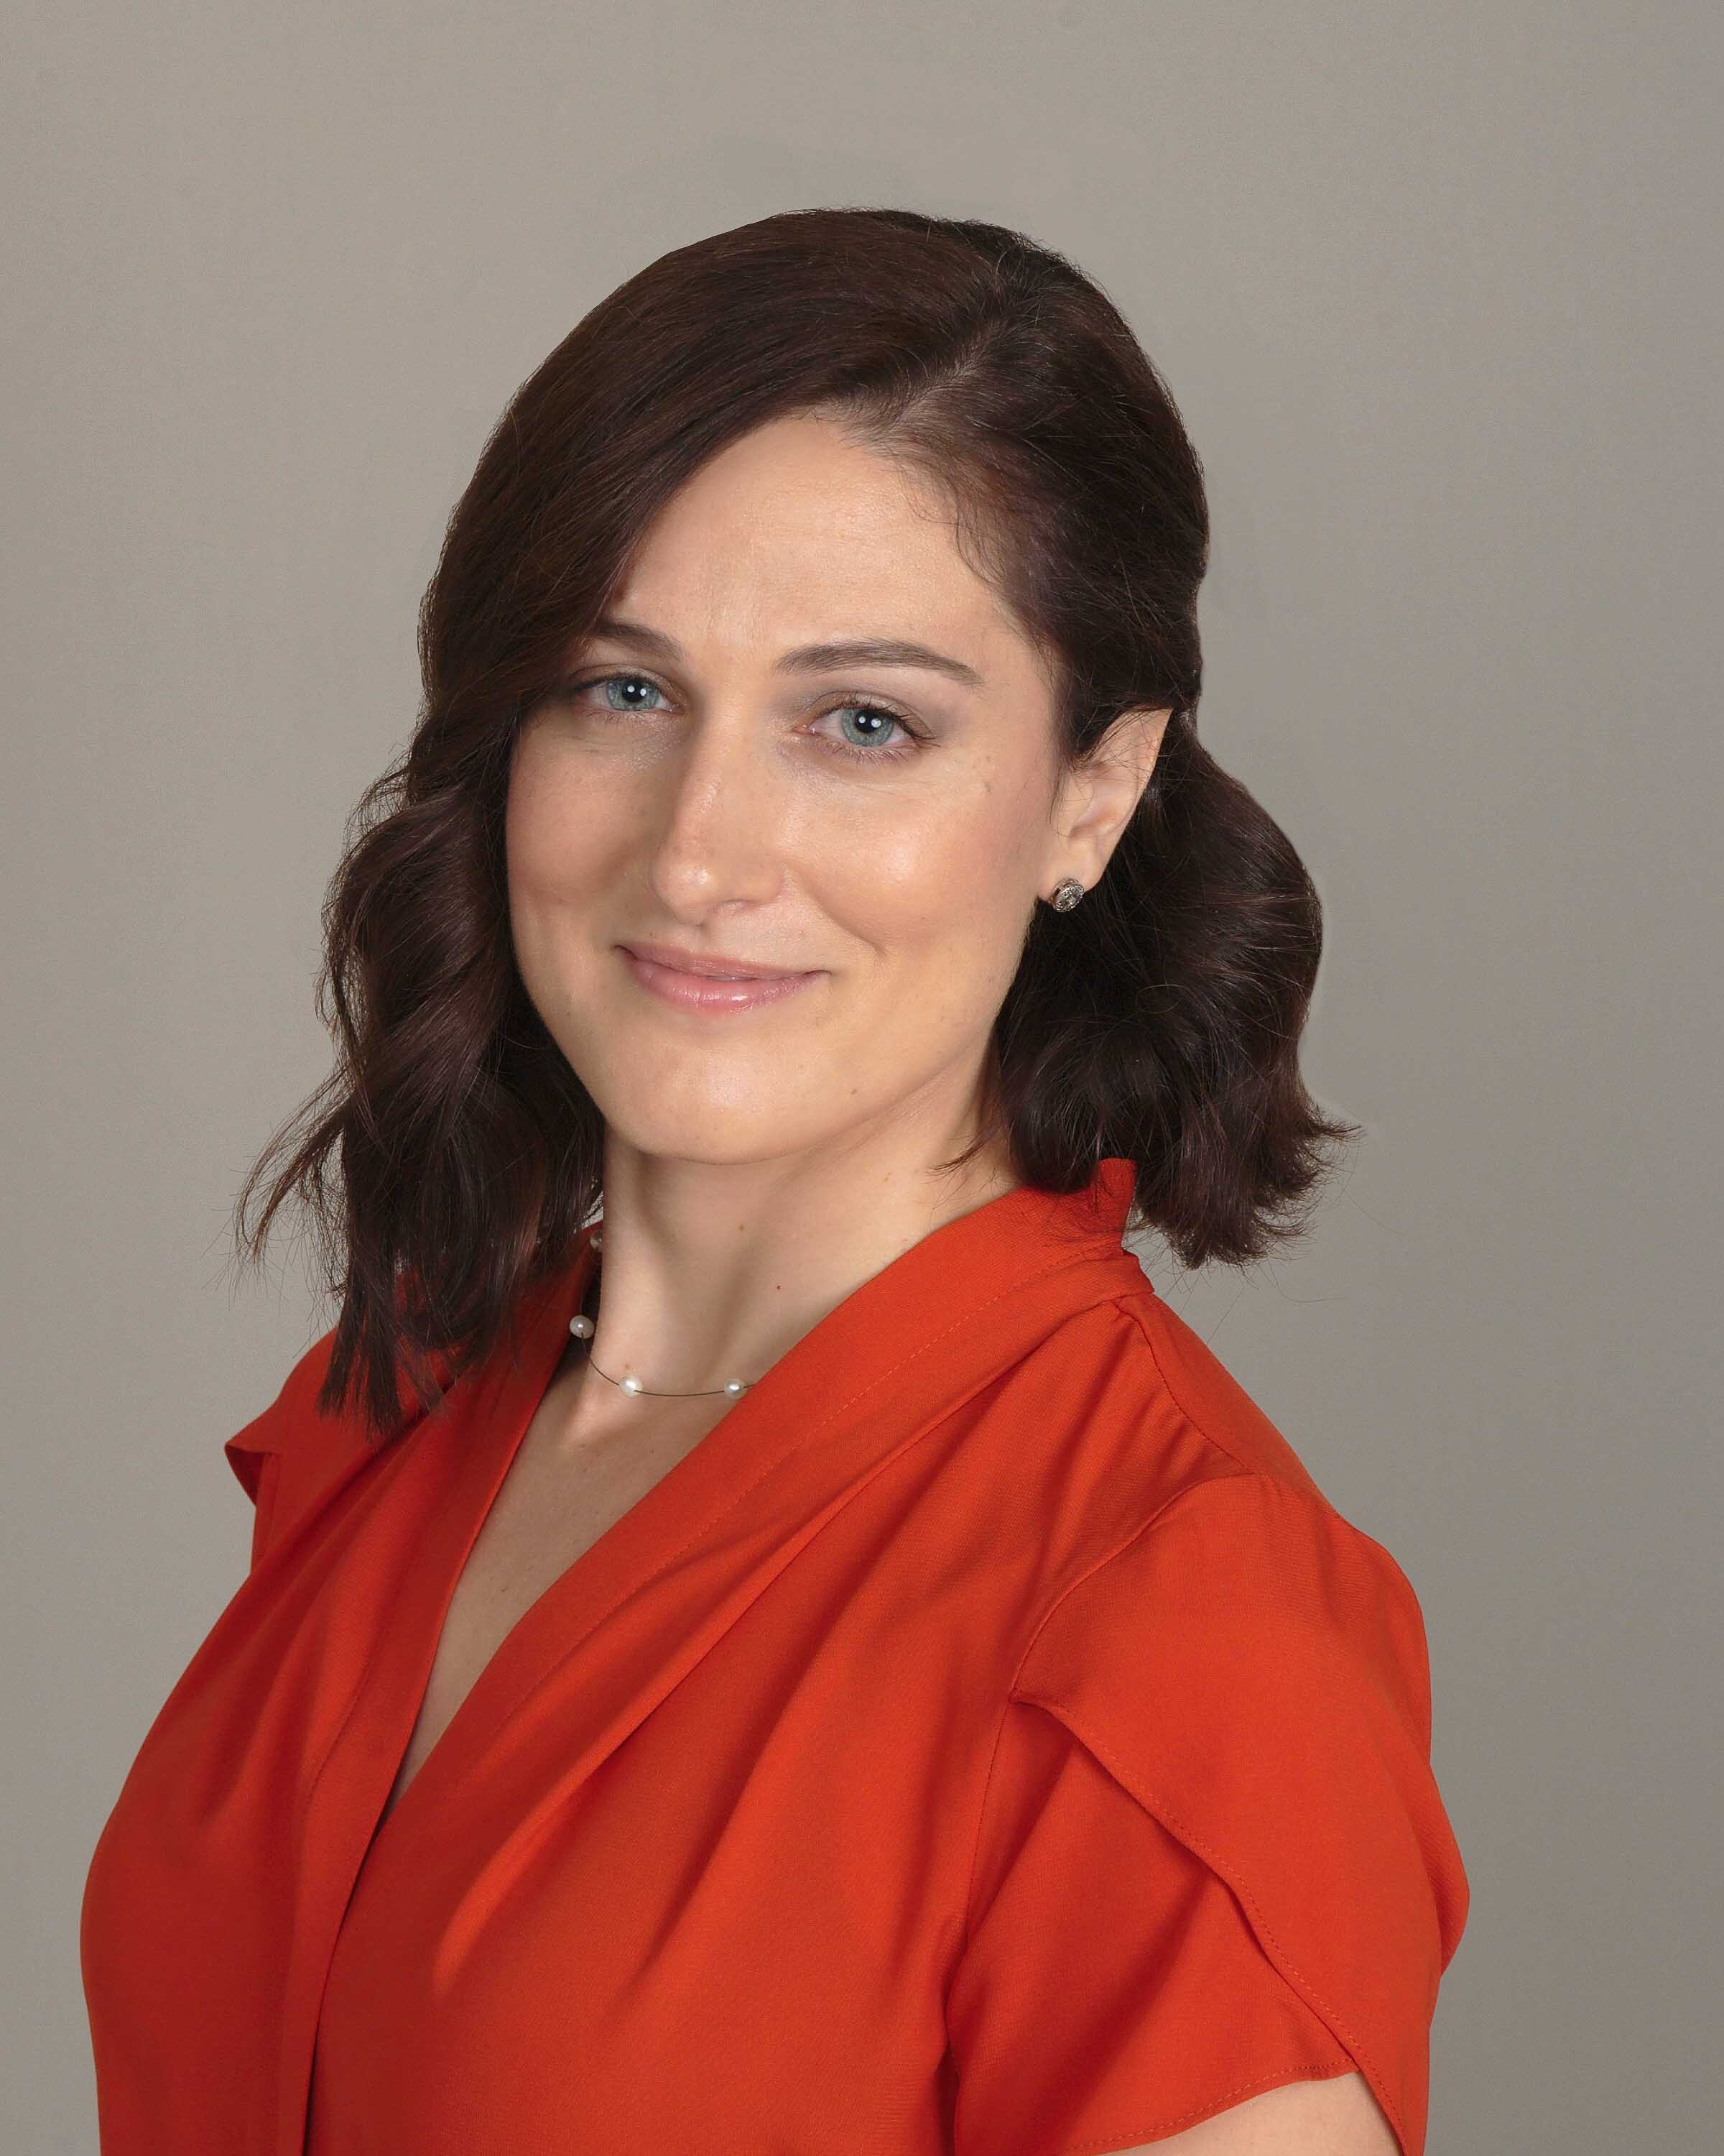
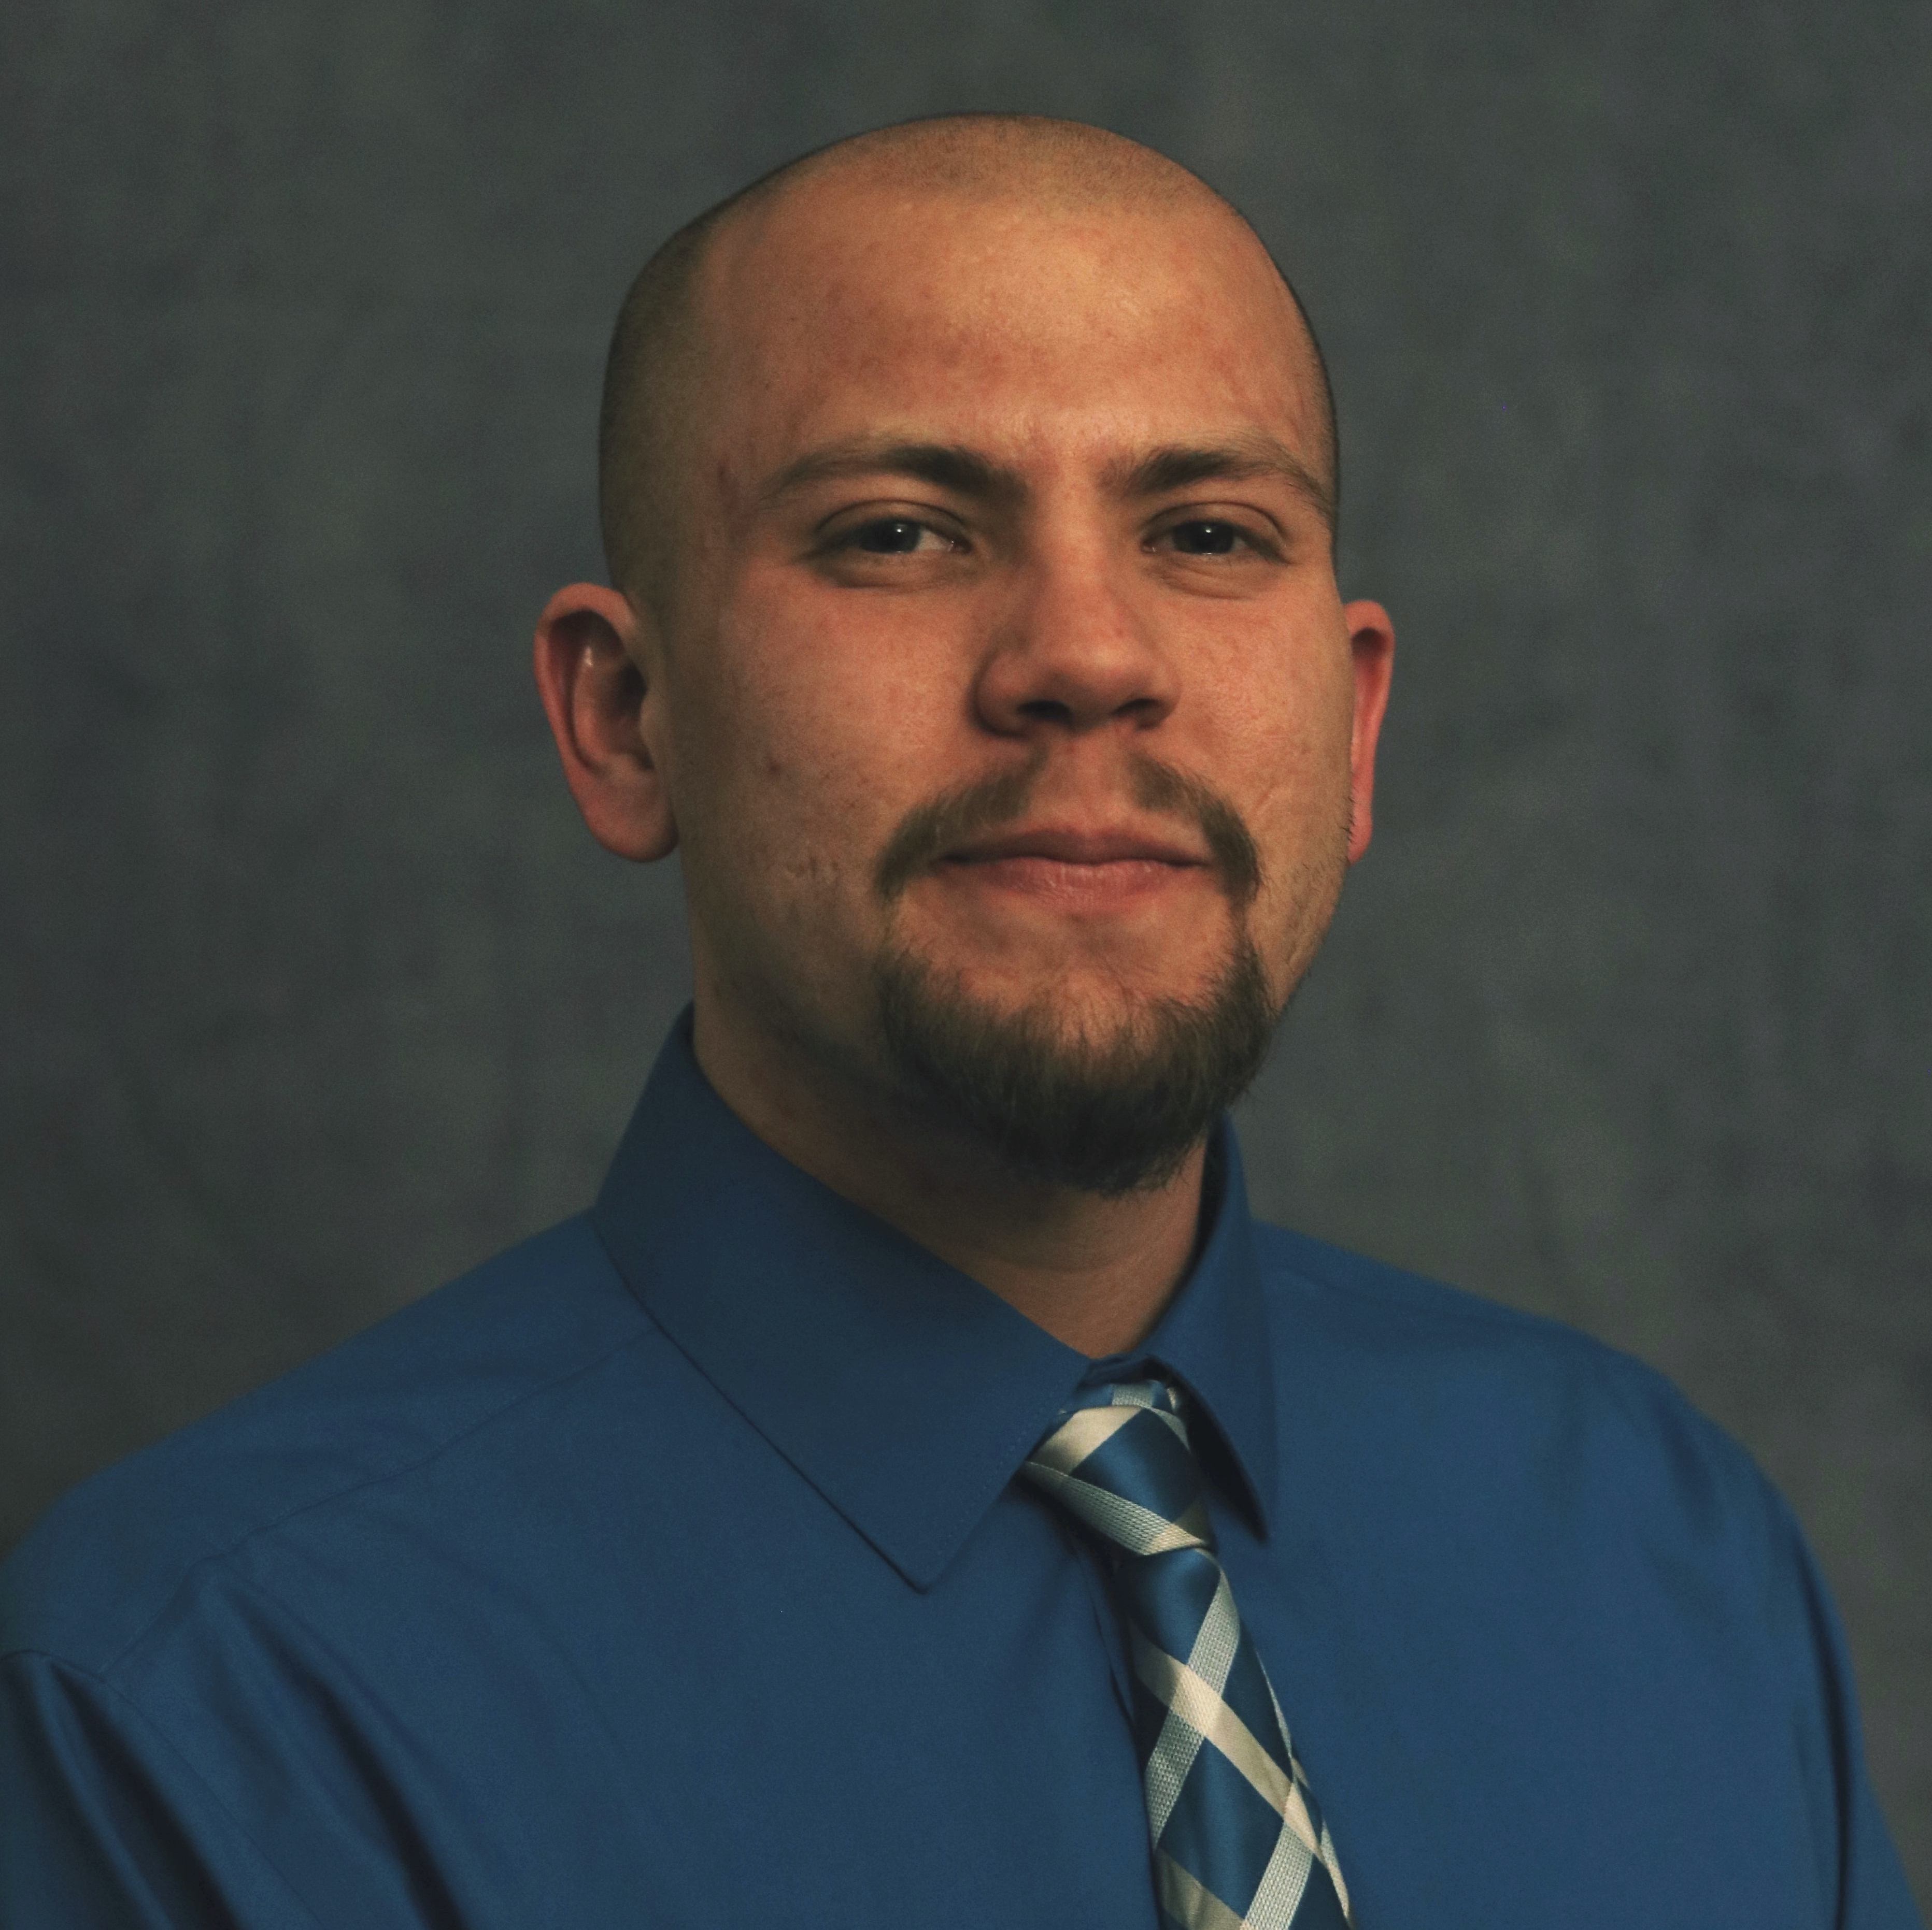
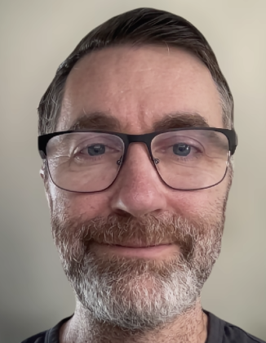


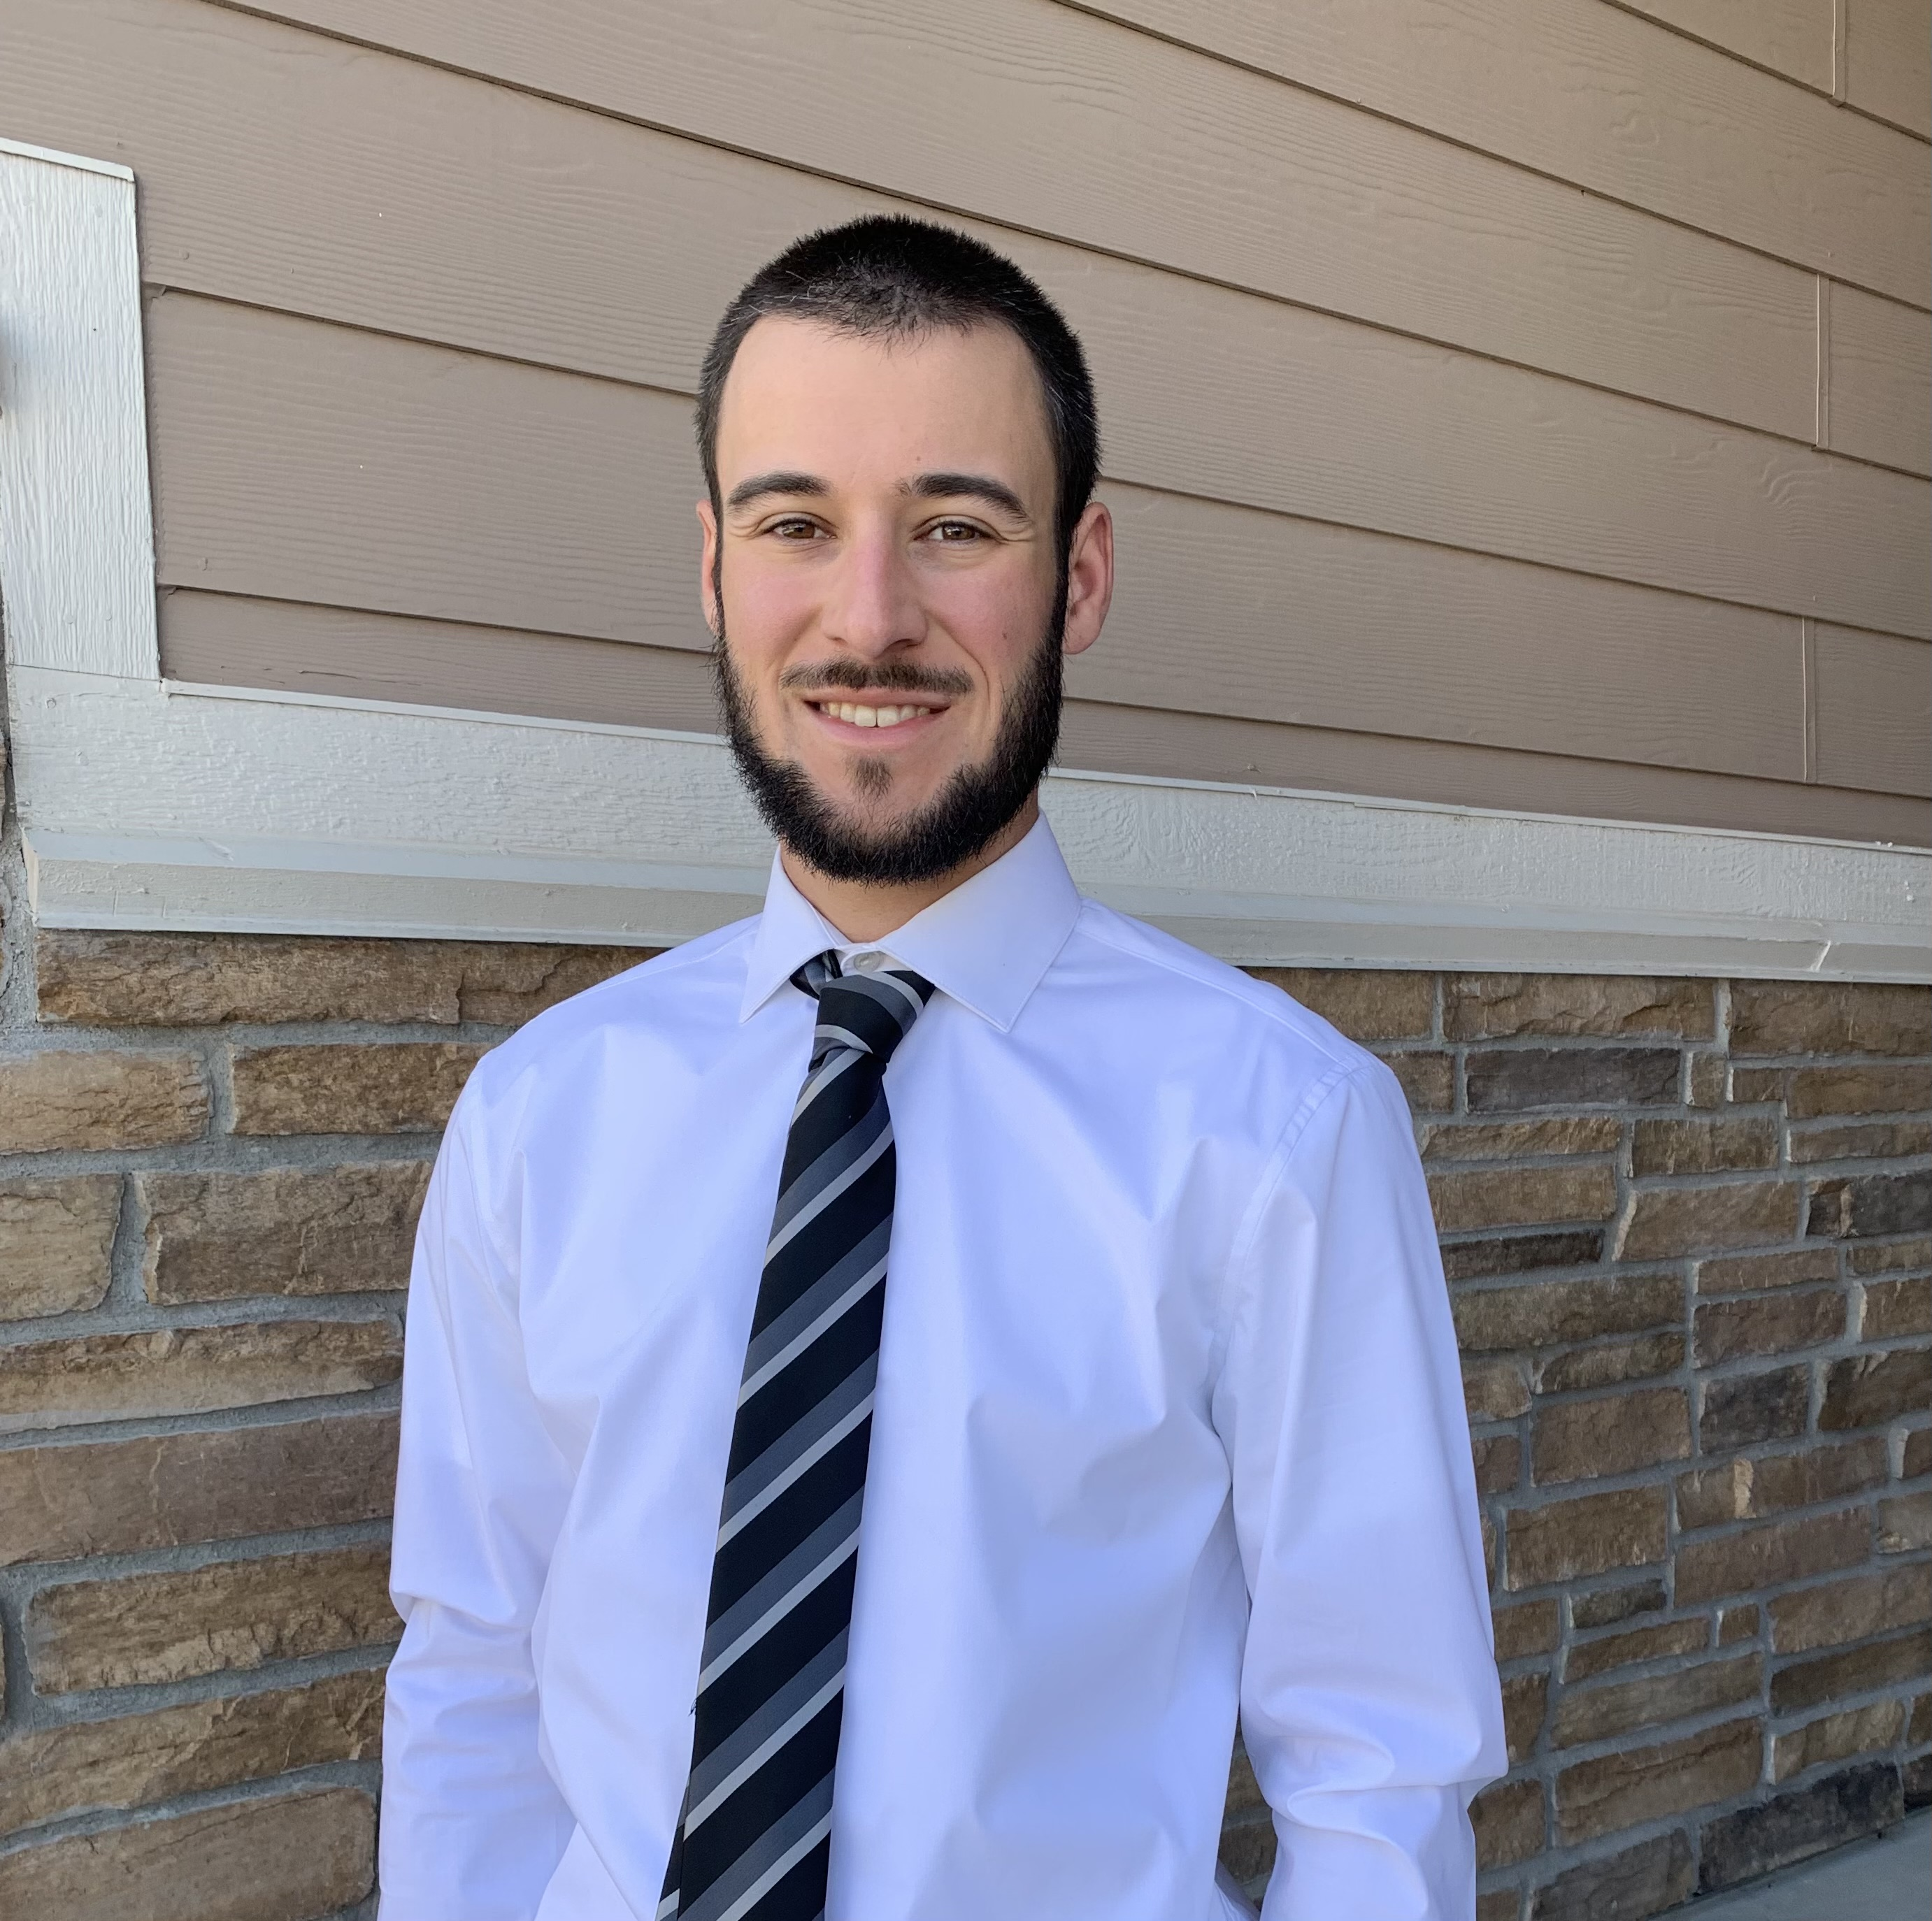


Meet the User Support Team
Layla Freeborn
Brandon Reyes
Andy Monaghan
Michael Schneider
John
Reiland
Dylan Gottlieb
Mohal Khandelwal
Ragan
Lee
3

Slide 4
Example Content
Important: This content should be readable to low-vision and blind users; visual elements (such as bolding, italics, color, etc.) should not be the sole method of demonstrating importance
Provide alternate, non-visual, means of emphasis, such as the use of key words (important, warning, attention, caution, note, etc.)
Format bullet points as a “list” in PowerPoint; do not manually add dashes or asterisks to create lists.

Slide 5
Example Content 2
All slides should have a unique title
Don’t forget alt text descriptions for images, or to mark decorative items as such – Everything you need to know to write Alt Text
Text size should be at least 18
Ensure high contrast – Color Contrast Checker
Avoid tables
Remember to check reading order using the “Selection Pane” tool
Review Tab > “Check Accessibility” > “Selection Pane”
Additional guidelines and recommendations can be found in CU’s Digital Accessibility Office: PowerPoint Accessibility Guidelines
Microsoft Accessibility Guidelines for PowerPoint: Making Powerpoint Presentations Accessible

Slide 6


Another example (with alt text)
/home ← Private!!!
/projects
/scratch
PetaLibrary Space

Slide 7
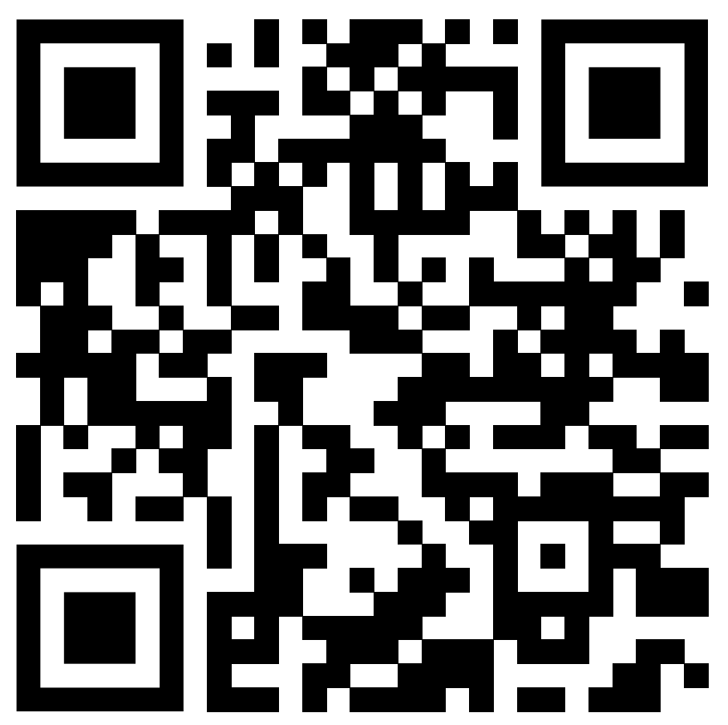
Documentation
https://curc.readthedocs.io/en/latest/

Slide 8
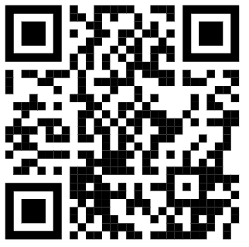
Survey and feedback
Survey: http://tinyurl.com/curc-survey18

